Slide 1
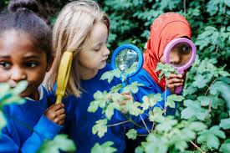
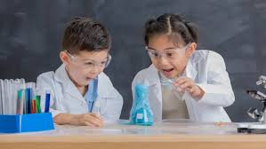
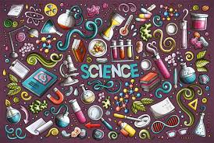
Science at Barleyhurst Park Primary School YOU will have interesting subjects to learn about YOU will grow your knowledge from one year to the next YOU are a scientist YOU will see science in the world around you YOU will ask questions then find the answers YOU will experiment, investigate and observe YOU will work indoors, outdoors, with equipment and speak to expert scientists to grow your knowledge

