Slide 1
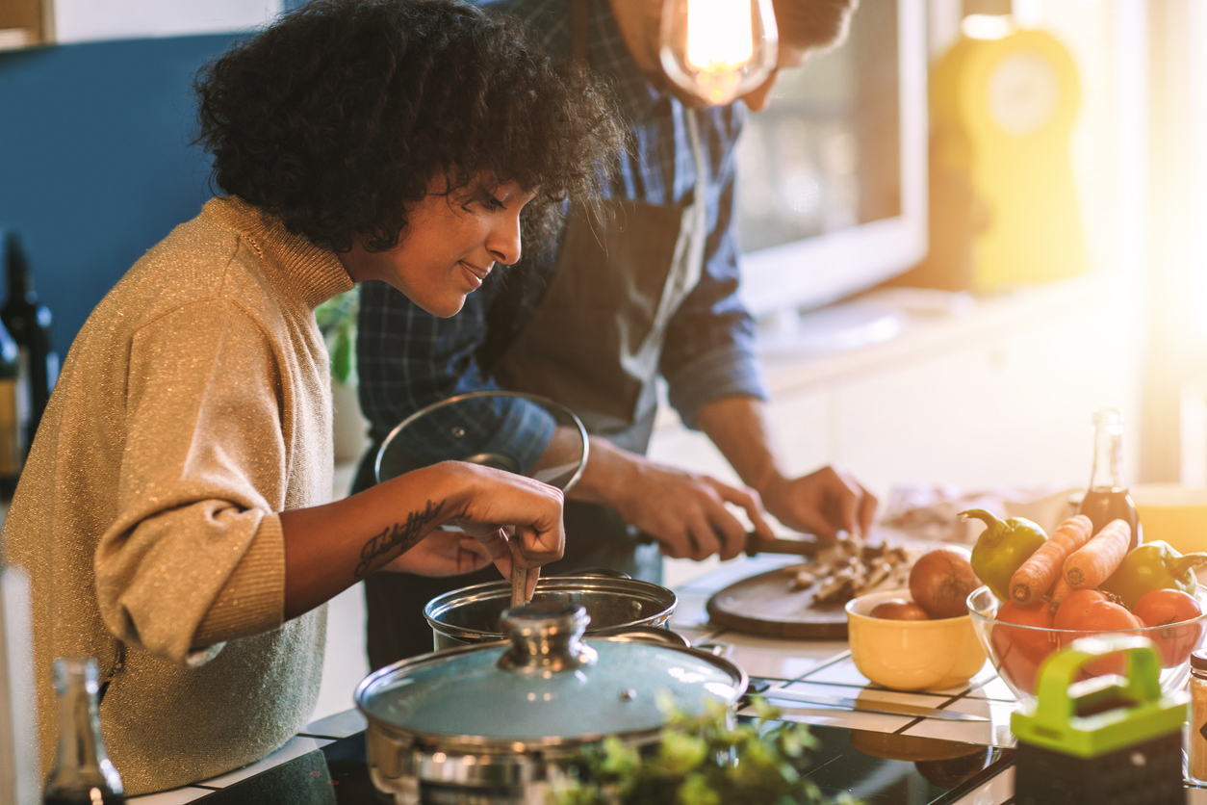

Healthy Home Cooking
Daisychain Family Centre
Monday 12:30-2:30 12th Jan – 10th Feb
Try new recipes and ideas.
Discover new flavours and ingredients.
Find inspiration for healthy family meals.
Explore ways to make your groceries go further and cook economically.
All ingredients and equipment will be provided
Please contact centre staff to book your space

